Slide 1
Section 2.2 Quadratic Functions
i) Completing the square
ii) Graphing y=a(x-p)2+q
iii) Using a,p,q to find vertex, opens up, down, congruency factor,
iv) Deriving and using the quadratic function
© Copyright all rights reserved to Homework depot: www.BCMath.ca

Slide 2
Vertex Form (apQ)
A Quadratic Function in APQ form is very easy to graph b/c it provides the vertex immediately
Using constants “a”,”p”, & “q”, we can find the vertex, which way it opens and the congruency value
Vertex:
Domain:
Range: Depends on which way the graph opens
Axis of Symmetry (AOS)
Graph opens up
Graph opens down
Y-intercept: Make x=0, solve for “y”
X-intercept: Make y=0, solve for “x”

Slide 3


Ex: For each of following equations, find the constants “a”, “p”, “q”, vertex, A.O.S., and intercepts
Y-int: (0,13)
No X intercepts
X-intercepts
Y-int: (0,$−3$)
X-intercepts
Since the vertex is on the x-axis, the x-intercept will be the same as the vertex
Y-int: (0,$48$)
© Copyright all rights reserved to Homework depot: www.BCMath.ca

Slide 4
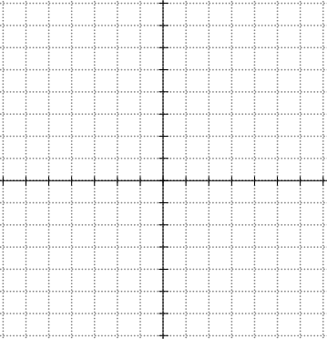
Graph parabola, label the vertex, AOS, intercepts, domain and range:
Y-int: (0,5)
X-int: (5,0) and (1,0)
© Copyright all rights reserved to Homework depot: www.BCMath.ca

Slide 5
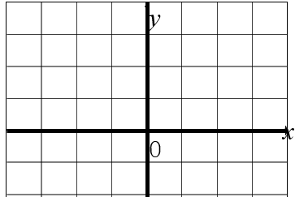
II) Constants “P” and “Q”
The constant “p” affects the graph horizontally
If “p” is positive, the graph moves to the right and if “p” is negative, it moves to the left
Graph is shifted two units to the left
Graph is centered on the Y-axis
Graph is shifted two units to the right
The constant “q” affects the graph vertically
If “q” is positive, graph shifts up, and if “q” is negative, graph shifts down
y
y
Graph is shifted two units up
x
x
0
0
Graph is shifted two units down

Slide 6
IV) Constant “a” (Congruency Factor)
The constant “a” determines the (congruency) width of the parabola and which way it opens
If “a” is positive (Opens up)
If ‘a” is negative (Opens down)
If “a” is big (Skinny)
If “a” is small (Wide)
Congruency Factor:
The constant “a” can be used to determine how fast the points on the parabola go up by
© Copyright all rights reserved to Homework depot: www.BCMath.ca

Slide 7
III) How does the constant “a” work?
7
7
Beginning at the vertex we can graph all the other points without making a TOV
5
5
Each point increases horizontally by 1 but increases vertically by 1 , 3 , 5 , 7 , 9, …
3
3
1
1
© Copyright all rights reserved to Homework depot: www.BCMath.ca

Slide 8
10
10
If “a = 2”, the points go up faster.
Each point increases horizontally by 1 but increases vertically by 2 , 6 , 10 , 14 , 18, …
6
6
Simply multiply the values by “2”
2
2
© Copyright all rights reserved to Homework depot: www.BCMath.ca

Slide 9
Practice: Graph the following Parabolas, Indicate the Vertex, AOS, intercepts, Domain & Range
10
0.5
1.5
2.5
6
3.5
2
© Copyright all rights reserved to Homework depot: www.BCMath.ca

Slide 10
VI) CTS: Complete the Square!
Completing the Square is a process that changes a quadratic functions from
General form: Standard Form:
Bracket the first two terms!
Divide the second term by 2 and square it! The purpose is to make the expression in the bracket into a perfect square!
Take the negative square outside of the brackets!
The trinomial becomes two equal binomials
Standard Form!
© Copyright all rights reserved to Homework depot: www.BCMath.ca

Slide 11
If there is a constant in front of x², factor that constant out first and then complete the square!
Bracket the first two terms!
Factor out any coefficient for x²
Divide the second term by 2 and square it!
Take the negative square outside of the brackets and multiply with coefficient in front!
The trinomial becomes two equal binomials
Standard Form!
© Copyright all rights reserved to Homework depot: www.BCMath.ca

Slide 12
Ex: Convert the following equations to APQ form. Then find the intercepts, Vertex, AOS, Domain and Range
Y-intercepts:
Y-intercepts:
X-intercepts:
X-intercepts:

Slide 13
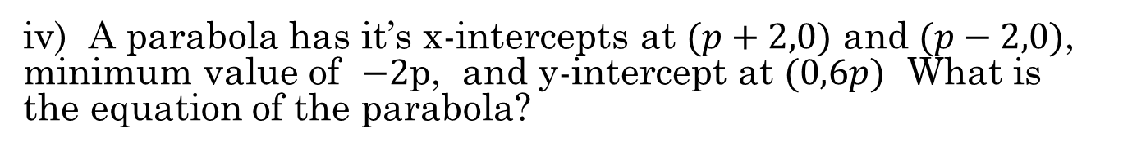
Practice Questions: i) A parabola has it’s vertex at (3,2) and crosses the point (8,10). What is the equation of the parabola?
ii) If the vertex of a parabola is at (3,-12) and y-intercept at (0,33), then what is the value of “a” in the equation of the parabola?
iii) A parabola with x-intercepts at (5,0) and (-2,0) has it’s y-intercept at (0,10). What is the equation of the parabola?
iv) A parabola has it’s x-intercepts at $(p+2,0)$ and $(p−2,0)$, minimum value of $−2$p, and y-intercept at $(0,6p)$ What is the equation of the parabola?

Slide 14
Practice Questions: i) A parabola has it’s vertex at (3,2) and crosses the point (8,10). What is the equation of the parabola?
With the vertex given, fill in the information in the APQ form
Use the point (8,10) to find the value of “a”
ii) If the vertex of a parabola is at (3,-12) and y-intercept at (0,33), then what is the value of “a” in the equation of the parabola?
This question is the same as the previous

Slide 15
iii) A parabola with x-intercepts at (5,0) and (-2,0) has it’s y-intercept at (0,10). What is the equation of the parabola?
Write this equation in factored form:
Now, plug in the y-intercept (0,10)
The equation of the parabola is:

Slide 16
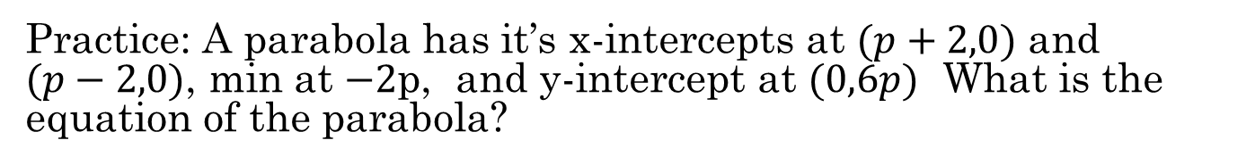

Practice: A parabola has it’s x-intercepts at $(p+2,0)$ and $(p−2,0)$, min at $−2$p, and y-intercept at $(0,6p)$ What is the equation of the parabola?
Write the equation in vertex form and factor form:
Plug the y-int into the equation
Plug the values of “p” into the equation
Case 1: p=0
Case 2: p=$\frac{8}{a}$
Not Quadratic
There’s a minimum point. So graph opens up and “a” is positive!
So the equation is:

